Slide 1
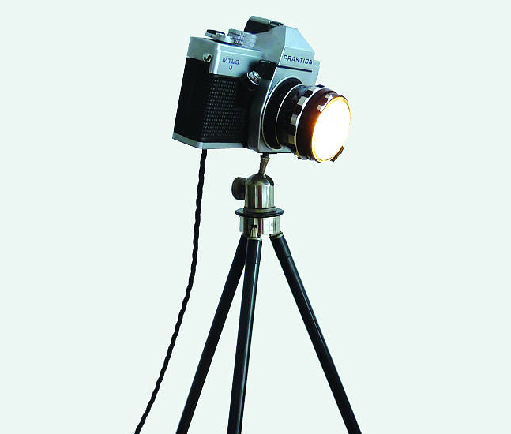
Photo Shoot Day
Jack Fowler – A2 Media

Slide 2
Location: You need a detailed description, including reasons, for your choice. Link your ideas to your magazine poster and your digipak.
The location that I have decided to use for my music video as well as the shooting for my digipak and magazine poster is “Ferry Meadows, Peterborough.” The reason for why I have chosen this location is mainly down to the scenery in which is viewed there, with the lake, the trees as well as the wildlife that are there. There are many different areas within Ferry Meadows in which I could use for different shots as well to when it comes to film my actual music video project. I believed that the location worked well the theme of the song and the paste of the song as the theme is about “Love,” she wants to be his so I thought a place with beautiful scenery would relate well to the theme of my song and would work well with it to, they would be supporting each other. I also thought about maybe this could be where her and the man she likes always comes, so in a way it could refer as a memory for her, where she relates him and the location together, meaning the location for my would be very effective and appealing for my digipak and magazine poster designs.

Slide 3
Will your magazine and digipak use similar images, props, costumes etc.? Explain
My magazine poster and my digipak would in a way use similar images, as the digipak will involve various shots of the location but they are both going to contain an image shot of her standing at the bridge looking out onto the lake, whilst at the same time focusing on the main prop of the “red envelope,” which this will be included within both the digipak and the magazine poster as it the main feature within the music video due to the envelope relating to the my song and the story that I want to be told throughout, it therefore links in, so I want it to be boldly appealed towards the audience as well as being on both designs the artist and the props are the main features. Costumes will be staying the same throughout the digipak and magazine poster design as they are both being centred around the same song “Yours” and I wanted to relate my costume within the lyrics of the song, in this case she will be wearing a winter coat as it matches in with the lyric line “I wear your winter coat” so the costume will stay consistently the same within both the digipak and the magazine poster design. The other thing was the camera angles in which I will be using, these are going to be various shots, such as close ups, mid-shots and long-shots. These then help support the impact in which the designs need to have, such as allowing us to see the artist more, getting to connect with her more as well as using wide shots to see the artist amongst the location that would be being used, it creates different impacts and I would believe the various of shots you would use make the designs more different and make those different impacts in which they would make towards the audience viewing them.

Slide 4
Transport to and from your location: equipment, props, costumes etc. (List of props and costumes needed, with reasons.)
The equipment in which would be needed for the shoot day is main use of the camera to be able to take the images, schedules and plans for what type of images I would need to be taking, so I know what images I would be aiming for to match my planned designs. The props would just need to be the red envelope as this the only and main prop that will be needed and because of it being a main feature within my music video I need to have this with me. The reason for having the envelope is because it is a prop that matches in with my song the idea of love and I thought an envelope would be the best way to show that love can be sealed up and the idea of the red connotes more the idea about it being to do with love. The costumes will consist of a winter coat to match in with the lyric lines that it involved and I will use a flowery shirt as well as plain blue jeans. This is because my artist “Ella Henderson” still wants to be seen as modern however still wanting to keep to her vintage personality so I wanted to keep that within my music video for my artist. The jeans show the modern appeal and the flowery shirt and the winter coat show the vintage appearance of the artist.

Slide 5
Shot types and angles need to be identified before your shoot day – give reasons for your choices.
The various shots in which I would like for my digipak and magazine poster are close ups, wide-shots, mid-shots and establishing shots. The idea of choosing these is because I wanted to add in different effects and impacts into my designs, so for example the close ups would allow the audience to connect more with the artist you see more of her, you connect with her emotions. I have used the mid-shot to show half of the artist for example when she is at the bridge, this can also connect in with the idea of using a wide-shot as well as it helps us see the artist within the various places at my location, creating the viewing of seeing both at the same time and linking them in together more. The establishing shot just allows us to see more of the location for where I will be going so that we know where the shots are taking place and the images would help to link in with the theme behind the video and make the designs more sharp and appealing.

Slide 6
Plan how many shots you intend to take – remember to have back-up images.
I plan on taking various shots as well as having back up shots of the images in which I will be taking. I will be taking at least different shots of the same such as the close ups of the artist, these will be took various times so that I have more of a choice to when it comes to choosing the right one for my designs, such as the various shots for location, I need to be able to have many so that they mainly match with my planned designs.
Close Ups – At Least 3 as well as having at least another 3 various back Ups
Establishing shots – At least 5 different shots of these to show various results – as well as back ups
Mid – Shots – At least 6 of these for various choice and at least many back ups
Wide - Shots – At least 6 of these as well as back ups
(These are only planned photos, more may be needed to be taken depending on any changes and improvements on them)

Slide 7
Timings for the day: arrival, departure, which locations you will use when, different shot types / model poses / costume changes etc. Be as specific as possible.
The times I will be arriving at Ferry Meadows in hopefully around 10:00am, depending on any traffic and delays and departure time will be around 3:30pm due to it getting dark early and the park’s closing time. I have planned for my filming as well as shot days to be done the 12th and 13th December 2015. I will be using the same location of Ferry Meadows, but using various parts of the park, such as the bridge and the hill areas as well as the best spaces/views onto the lake. The costumes will not be changing during the shooting they will be staying the same. The model poses will be various such as leaning against benches, looking straight onto the lake as well a standing/sitting side on holding the envelope. The shot types taking place will be various as stated above such as the close ups, mid-shots, wide-shots and establishing shots to create the various shots and impacts they would create for the viewing audience.

Slide 8
Models: Do you have a back-up plan for illness etc.?
The current artist who is taking part in my project is “Jade Ayling,” and she has confirmed to do this and has took days of from work to be in my music video as well. However, if Jade was unable to do the filming because some comes up or she becomes ill I have asked “Alysha Warby” to take her place as a backup and she has agreed to. Alysha will be coming with me and Jade on the day of filming just in case any of these changes are needed to be made.

Slide 9
Weather conditions – are there forecasts available? How will this affect the outcome of your shoot?
When it comes to weather conditions these have been thought about. As I have planned my filming for the 12th and 13th December there are currently no weather forecasts being shown for these days until sooner to the dates. For example if it rains on the day of filming then we would have to cancel the filming until another time, due to it not being relevant to my music video and because of us being in an open area we would get wet as well as the prop and equipment, so hopefully it doesn’t rain, however if it is cold and possibly dull then the filming would still take place, it would all just depend on the weather for those dates.

